Slide 1
PowerPoint Presentation Template Planning Ahead: Advance Care Planning and End-of-Life Decisions
This presentation is intended as a template.
Modify and/or delete slides as appropriate for your organization and community.
To view speaker notes and edit presentation, click 'Edit‘, then 'Edit slides.'
Delete this slide before use.
Add your organization’s name & contact info – and logo if you like

Slide 2
Planning Ahead: Advance Care Planning and End-of-Life Decisions

Slide 3
Interesting to note…
Most Americans – 88 percent – feel comfortable discussing issues relating to death and dying.
Yet research has found that only 42% have a living will.

Slide 4
Our Goals
Discuss advance directives and end-of-life care decisions.
Learn the different types of advance directives.
Recognize advantages and disadvantages of advance directives.
Identify resources that can help you complete your advance directives.
Notes:
Purpose of our discussion today is to:
Discuss advance directives and end-of-life care health care decisions
Learn the different types of advance directives
Recognize advantages and disadvantages of advance directives
Know resources that can help you complete your advance directives

Slide 5
Why You Need an Advance Directive
Your wishes will be known
Only used if you are unable to express your decisions
This can happen to anyone - at any age
Give your loved ones the gift of peace of mind – write down your wishes!
Notes:
Why YOU need advance directives:
If you have a sudden accident or illness – your wishes will be known
As long as you are able to express your decisions your advance directives will not be used
You may lose the ability to participate in decisions about your own treatment
Give your loved ones the gift of peace of mind – write down your wishes!

Slide 6
What are Advance Directives?
A written statement of your wishes, preferences and choices regarding end-of-life health care decisions.
A tool to help you think through and communicate your choices.
It is a road map for your future health care.
Notes:
Advance Directives:
Are a written statement of your wishes, preferences and choices regarding end-of-life health care decisions
List your wishes, preferences and choices regarding end-of-life health care decisions in the event you can not speak for yourself
Are a tool to help you think through and communicate your choices
It is a road map for your future health care

Slide 7
Advance Directives
Written instructions about future medical care are only used:
If you are seriously ill or injured AND
Unable to speak for yourself
Two parts to an advance directive:
Living will
Medical (health care) power of attorney
Notes:
Note: Each state regulates the use of advance directives differently.
Generally advance directives are:
Oral and written instructions about future medical care
Only used if you are seriously ill or injured AND unable to speak for yourself
Two documents that make up an advance directives:
Living will
Medical power of attorney – or deciding who will speak for you if you cannot speak for yourself?

Slide 8
Living Will
A living will is one part of an advance directive.
A legal document with your wishes about medical treatment
You choose what you do want & don’t want
Think of it as a route on your map
It’s YOUR journey
Notes:
Your right to accept or refuse treatment is protected by constitutional and common law through a living will.
A Living Will is a legal document with your wishes about medical treatment.
You can choose what treatments you want and do not want.
A living will, like a route marked on a map, indicates which direction you’d like to take at each fork in the road.
It’s your journey – and you decide which roads you want to take and when.

Slide 9
Medical Power of Attorney
A document that specifies who you want to make decisions about your medical care
The person is authorized to speak for you ONLY if you are unable to make your own medical decisions
May also be called:
"health care proxy or agent"
“health care surrogate”
"durable power of attorney for health care"
Notes:
Medical Power of Attorney can be used at anytime - Not only at the end of life!
This is a legal form that states who you want to make decisions about medical care.
The person is authorized to speak for you any time ONLY if you are unable to make your own medical decisions.
In essence, this is your back up driver so that when unexpected road blocks appear along your health care journey, your back-up driver is able to choose a detour that is in keeping with your values, wishes and choices.
May also be called:
"health care proxy or agent"
“health care surrogate”
"durable power of attorney for health care“
Gives a much broader scope of decisions than the living will document.
Complete both parts of your advance directives to protect your wishes for care at the end of life, or simply name your medical power of attorney to ensure the right person will speak on your behalf.

Slide 10
Advance Directive: Advantages
You are in charge of making your own decisions
Documents can be changed anytime
You DO NOT need an attorney
Documents can help you express your wishes
Forms are available for FREE at www.caringinfo.org
Notes:
Advantages of advance directives are:
You are in charge of making your own decisions
Documents can be changed anytime
You DO NOT need an attorney
Documents can help you take initiative with family and doctor to express wishes
Forms are available for FREE at www.caringinfo.org

Slide 11
Advance Directive: Disadvantages
Advance Directives (AD) may not be available when needed
Not readily available in a patient’s chart
Living wills:
may not be specific enough
may be overridden by a treating physician
does not immediately translate into physician’s orders
Notes:
Messages here:
Discuss where to keep advance directives and not
Make sure you give your health care agent a copy of your AD, plus family and doctor
Always complete a medical power of attorney document, not just a living will!

Slide 12
Medical Terms: End-of-Life Care Decision Making
Life-Sustaining Treatment
Artificial Nutrition and Hydration (tube feeding)
Cardiopulmonary Resuscitation (CPR)
Do-Not-Resuscitate Order (DNR)
Palliative Care
Hospice
Notes:
Describe definitions of each.
Go to www.caringinfo.org, then ‘Advance Care Planning’, then ‘Glossary’ for definitions.

Slide 13
Other Directives
POLST – Portable Medical Orders for Life Sustaining Treatment
In some states it is known as MOLST – Medical Orders for Life Sustaining Treatment
Five Wishes
Online advance directive services are becoming more common:
MyDirectives
Caring Advocates
Mideo
Vimty
Vital Decisions

Slide 14
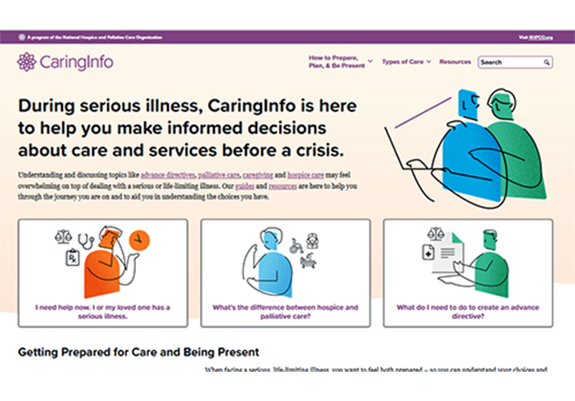
FREE Resources at www.CaringInfo.org
Free state-specific advance directive forms
Information on ‘Planning ahead’ and talking with loved ones and care providers

Slide 15
QUESTIONS?

Slide 16
THANK YOU!

