Slide 1
NHPCO COVID-19 Update
April 16, 2020 nhpco.org/coronavirus
Your line has been muted upon entry. If you need assistance, please use the Q&A tool.

Slide 2
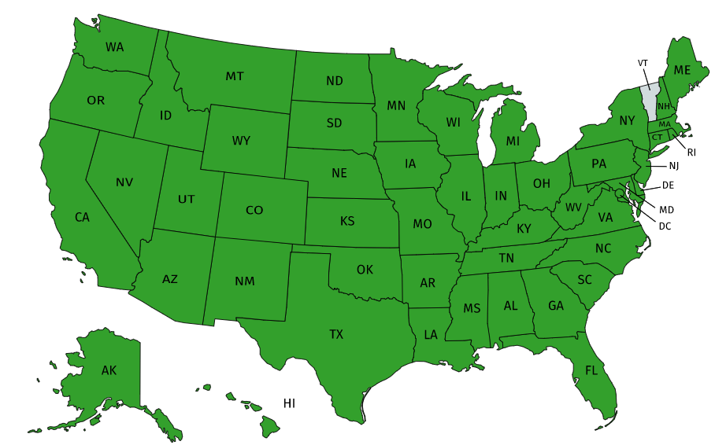

Slide 3
Today’s Agenda and Faculty
Edo Banach, JD
President and Chief Executive Officer
NHPCO
Jennifer L. Kennedy, BSN, CHC, EDD, MA, RN
Senior Director, Regulatory and Quality
NHPCO

Slide 4
Today’s Agenda and Faculty
Regina Bodnar
National Director
Carroll Hospice
Westminster, MD
Sarah McSpadden, CHC, MSN, RN
President and Chief Operating Officer
The Elizabeth Hospice
Escondido, CA
Robert Parker, CENP, CHP, CHPN, DNP, RN
Chief Clinical Officer, Chief Compliance Officer
Intrepid USA Healthcare Services
Carrollton, TX

Slide 5
Disclosures
The faculty and planners for today’s webinar have no relevant financial relationships with commercial interests to disclose.

Slide 6
Logistics: Reminders for Participants
Audio lines are muted to reduce background noise. You will not be able to unmute yourself.
If you need assistance: Use the “Q&A” feature.

Slide 7
Logistics: Reminders for Participants
At the conclusion of the presentations we will have time for questions.
Submit a question at any time by using the “Q&A” feature.
A recording of the presentation and presentation slides will be posted to www.nhpco.org/coronavirus

Slide 8
Edo Banach, JD
President and Chief Executive Officer
NHPCO

Slide 9
Jennifer L. Kennedy, BSN, CHC, EDD, MA, RN
Senior Director, Regulatory and Quality
NHPCO

Slide 10
Emergency Preparedness

Slide 11
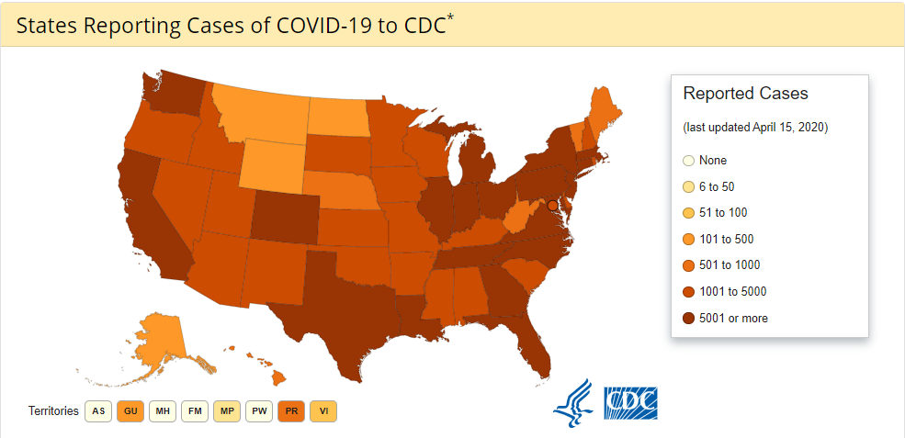
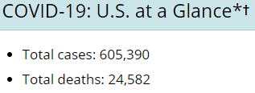

Slide 12
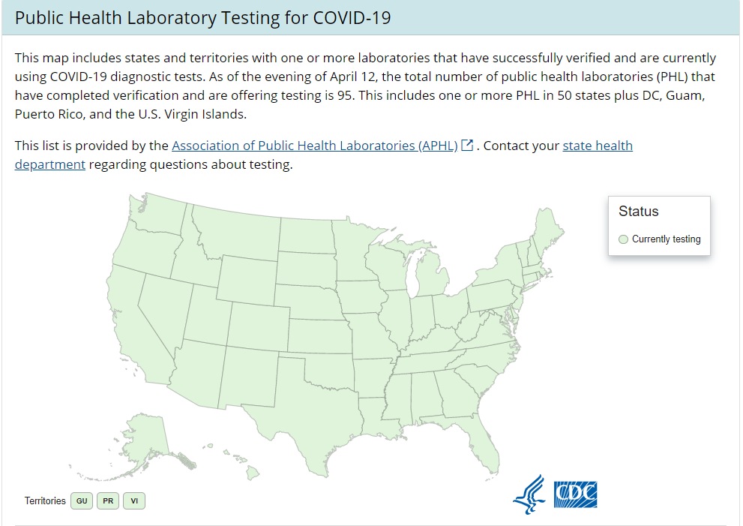

Slide 13
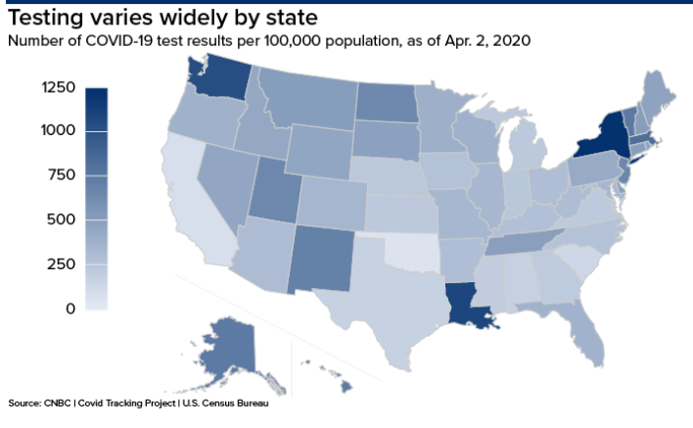

Slide 14
Emergency Management Check-in

Slide 15
Crisis Standards of Care (CSC)
“Crisis standards of care” is defined as a substantial change in usual healthcare operations and the level of care it is possible to deliver, which is made necessary by a pervasive (e.g., pandemic influenza) or catastrophic (e.g., earthquake, hurricane) disaster. This change in the level of care delivered is justified by specific circumstances and is formally declared by a state government, in recognition that crisis operations will be in effect for a sustained period. The formal declaration that crisis standards of care are in operation enables specific legal/regulatory powers and protections for healthcare providers in the necessary tasks of allocating and using scarce medical resources and implementing alternate care facility operations.
Crisis Standards of Care: A Systems Framework for Catastrophic Disaster Response: Volume 1: Introduction and CSC Framework (2012)

Slide 16
Stakeholders at the Table for CSC Discussions
State and local public health agencies;
State disaster medical advisory committee;
State and local EMS agencies (public and private);
State and local emergency management agencies;
Health care coalitions (HCCs) and their representative health care organizations, and where appropriate,
U.S. Department of Veterans Affairs Medical Centers and Military Treatment Facilities that are part of those HCCs;
State associations, including hospital, long-term care, home health, palliative care/hospice, and those that would reach private practitioners;
State and local law enforcement agencies;
State and local elected officials;
Crisis Standards of Care: A Toolkit for Indicators and Triggers
State and local behavioral health agencies;
Legal representatives and ethicists; and
Nongovernmental organizations that may be impacted by implementation of CSC (AABB, American Red Cross local chapter, etc.).

Slide 17
CSC Implementation
Look to your state emergency management agencies and local public health departments for information about state specific implementation of CSC

Slide 18
Your COVID-19 Emergency Management Plan
The plan is a work in progress.
Are you at “the table” with your state emergency management agency and local coalitions or community planning groups?
Evaluation of response is key to updating processes for improved response.
How often are you evaluating your response?
How often are you revising your plan?
Adding/revising policies/procedures
How are you communicating/educating staff about plan updates?
Are you validating and documenting staff education and competency with changes to the plan?
Are you tracking utilization of resources and costs?

Slide 19
States Who are Just Ramping Up
Be proactive now for preparation
Plug into your state emergency management agency and local public health departments
Prepare your staff and community for what is to come
Develop your COVID-19 plan within your emergency anagement plan
Specialty/revised policies/procedures
Evaluate staffing based on quarantine parameters
Evaluate ability to facilitate telehealth visits

Slide 20
States Who are Just Ramping Up
Determine if you have capacity to admit and care for a patient who is exposed or active COVID-19
Assess PPE supplies and determine ability to obtain ongoing supply
Educate staff now
Review your infection control plan and validate staff competency
Review emergency management plan policies/procedures
Execution and documentation of telehealth visits

Slide 21
Panel Discussion

Slide 22
Today’s Faculty
Regina Bodnar
National Director
Carroll Hospice
Westminster, MD
Sarah McSpadden, CHC, MSN, RN
President and Chief Operating Officer
The Elizabeth Hospice
Escondido, CA
Robert Parker, CENP, CHP, CHPN, DNP, RN
Chief Clinical Officer, Chief Compliance Officer
Intrepid USA Healthcare Services
Carrollton, TX

Slide 23
How is it Going Out There?

Slide 24
Working Remotely
How is that working for your staff?
What are the challenges you have encountered?
What technology have you leveraged?
What are key factors for successful remote work?
What have your learned from the experience?

Slide 25
Working with Facilities
Hospitals
Nursing and skilled nursing facilities
Assisted living facilities
Personal care homes
Access issues
Referrals to hospice or palliative care
COVID-19 positive or exposed patients

Slide 26
Resources & Supplies
Access to Resources
COVID-19 tests
Access to supplies
Personal Protective Equipment (PPE)
Other supplies

Slide 27
Patient/Family Visits (In Person and Telehealth)
In person visits vs. telehealth visits
Variables? Determinants?
Patient assessment via telehealth
Physical assessment – how accomplished?
Clinical skill development
Staff skills and comfort level for completing telehealth assessments
Any measurement of outcomes related to telehealth visits?

Slide 28
Quality of Patient and Family Care
What does quality of care look like during a public health emergency?
Determining/respecting patient/family wishes when COVID-19 infection is a factor.
What quality of care targets can providers attempt to accomplish?
What are quality of care expectations of patients/families during this emergency event?
Is quality of care still a significant focus for you in your daily work with patients and families during this pandemic?

Slide 29
Pearls of Wisdom
What have you learned thus far that you would like to share with other providers?

Slide 30
Questions?
Submit a question using the “Q&A” feature

Slide 31
Thank you for your participation
CE/CME Credit – link will be sent via email
Identify the type of credit you want to receive
Evaluate the webinar by April 24, 2020
Print or email your CE/CME Certificate or Certificate of Attendance

Slide 32
nhpco.org/coronavirus

Slide 33
Thank you for your participation
Contact us:
covid19@nhpco.org
800-646-6460

