Slide 1
Current and Emerging CMS Payment Models
Intersection between Hospice, Palliative and Primary Care

Slide 2
High Level Agenda
Understanding Medicare’s Urgency - the Why and Why NOW!
Recent Economic Model Announcements – CMS Actions Their Strategy
Risk Intermediaries – Beyond “Value Based”
New Expectations and Requirements – New Competition
Economics of evolution – How to THRIVE in the new economy

Slide 3
Learning Objectives
Learning Objective 1: describe how Primary Care First and Seriously Ill Populations will effect my hospice in 2020
Learning Objective 2: understand how SIP program will provide reimbursement for services you cannot bill for today
Learning Objective 3: evaluate earlier access to hospice-ready or soon-to-be hospice appropriate patients
Learning Objective 4: increase referrals through stronger relationships with community providers and with Medicare Advantage payers, giving you an advantage over other hospices
Learning Objective 5: achieve 20-25% gross margins in a program that increases visibility to 12 months of patients, who already qualify for hospice while getting paid to support their adoption of the benefit for the full 6 months

Slide 4
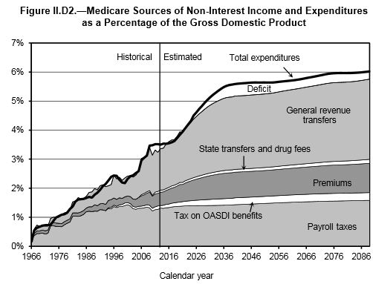
Impact of Administrations on Medicare Deficit Projections
Even including a significantly higher GDP growth rate, current administration projects higher health care spending and higher Medicare deficits
Obama Administration
Trump Administration

Slide 5
Current Medicare Projections
Current projections
  Optimistic GDP growth rates
  Optimistic Savings rates
“Medicare is growing by more than 10,000 beneficiaries per day.”
  Growth in population will slow, aging demand front is still accelerating
  Medicare is currently growing at ~$135,000,000 per day (CMS Office of the Actuary)
  156,000,000 wage earners (BLS.GOV)
  $.88 per day in growth
  $321/wage earner/year
Part A bankruptcy – in 6 years x $321/year = $1,921/wage earner or $160/month in tax increases to achieve breakeven on growth
  $45-50 billion in Part A overspend per year in 2024-2026 ($320/wage earner)
Know any politician that will run on tax increases (google Walter Mondale)?
  Possible budget solution…. Medicare Advantage/Medicare ACO++ for ALL

Slide 6
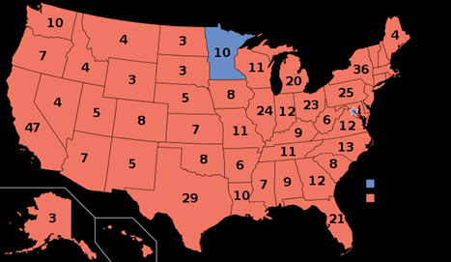
Reagan vs. Mondale Electoral Map

Slide 7
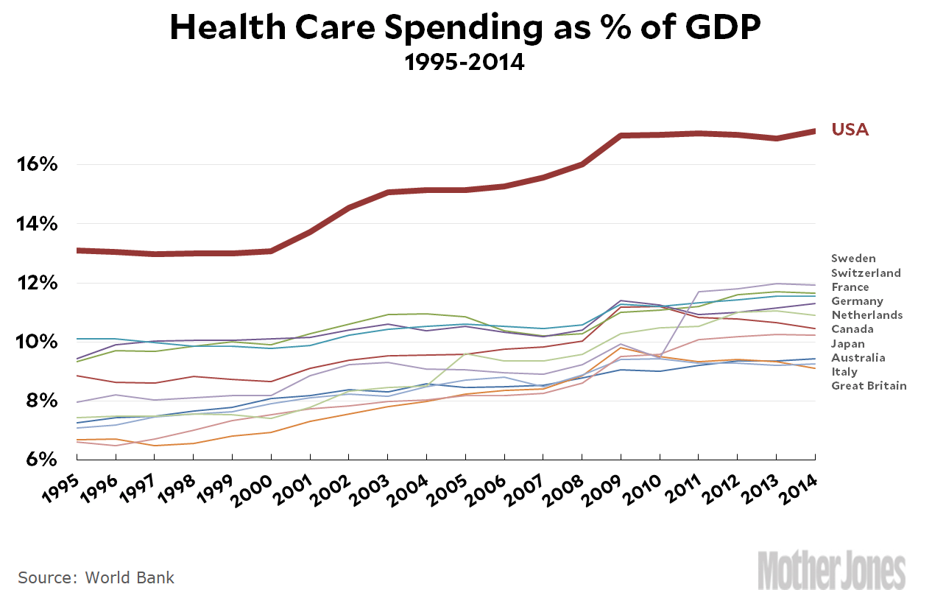
Guideposts and Common Elements
Politics of Quality
  Mission Critical Enabler for Politicians
Patient (Voter) Centered
  Few patients can truly advocate for their best interests
Moving Regulation of Process to Regulation of Outcome
  Mammography is a case study in policy change
Moving Healthcare back to 15% of GDP from 18%
  U.S. will never get to 12%, but what is a better expenditure

Slide 8
Recent CMS Announcements - ACOs
Medicare Shared Savings Program
  Six Levels of Risk – A through E + Enhanced (next slide)
Next Generation
  Complex Benchmark
  Discount “off the top” Driven by Sharing Rate
  Small RAF Adjustment
  Network Discounts Available through Population Based Payment (PBP)
Direct Contracting Entity – Next Generation ++
  Announced Improved Benchmark Formula
  Par providers MUST agree to capitation
  Part B only model 50/50 risk with limit based on provider revenue
  Global A & B 100% to DCE with global loss limit
  Geographic (reboot of Health Plan PFFS)
  Many Unknowns

Slide 9
Program Comparison
Level A Track 1 | Level B Track 1 | Level C New | Level D New | Level E Track 2 | Enhanced Track 3 | DCE Part B | DCE Global Next Gen | DCE Geographic
40% sharing | 40% sharing | 50% sharing | 50% sharing | 50% sharing | 75% sharing | 50% sharing (Part B only) | 100% risk after discount to CMS | 100% risk after discount to CMS
Upside only | Upside only | 1st dollar losses at 30%, not to exceed 2% of FFS revenue, capped at 1% of BM | 1st dollar losses at 30%, not to exceed 4% of FFS revenue, capped at 2% of BM | 1st dollar losses at 30%, not to exceed 8% of FFS revenue, capped at 4% of BM | 1st dollar losses 40 - 75%, not to exceed 15% of BM | 50% U/D unlimited PCP Cap @7% BM PPO providers paid FFS Net | 100% unlimited Cap to DCE for PPO providers PPO provider paid??? Cap for PCP is expected | 100% unlimited Cap to DCE and all claims processing to DCE
MIPS AIM | MIPS AIM | MIPS AIM | MIPS AIM | Advanced APM | Advanced APM | Advanced APM | Advanced APM | Advanced APM
 |  |  |  | Advanced APM = 5% increase in Medicare Fee Schedule

Slide 10
Diagnosis Based Efforts
ESRD and Oncology “ACOs”
First results have been positive
2018 results to be announced soon
Findings likely to be incorporated in “regular” ACOs

Slide 11
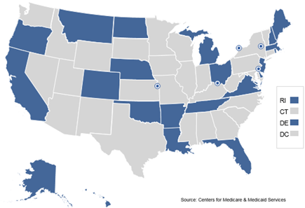
Primary Care First (PCF) and Significantly Ill Populations (SIP)
PCF (Patients w/ a PCP)
  Complementary to all but Next Generation and DCE model ACOs
  End FFS for PCP Practices
  PCPs paid capitation based on risk score of their panel plus per visit flat fee
  Quality gateway before bonus
  Bonused on acute hospital utilization 1st year, then typical measures
SIP (Patients w/o a discernible PCP)
  Extra payment for care intervener
  Transition patient to PCP promptly (possible exceptions)
  Extra payment to PCP to take on SIP

Slide 12


Risk Intermediaries – Beyond “Value Based”
Precision in Definition of Risk
  Starts & Stops, Geographic, Dx, Procedural
Disconnecting Margin from Care Transactions
  Place of Service, Blizzards & Hurricanes
  Measuring Things that Didn’t Happen
New Top Line Metrics
  Population, Quality, Retention, RAF
  Whose Revenue is Your Cost
Managing Risk
  Reinsurance, reserves, variable vs. full cost
  Balance Sheet vs. Strategy (Career) Protection
They are both farmers…
This Photo by Unknown Author is licensed under CC BY-SA

Slide 13

Expectations and Requirements
Allopathic & Most Osteopathic Care is Care De Jour (of the day)
Palliative Care is Care De la Vie (of life)
Hospice Care is Care Pro Vivis (for the living)
Operational Gain | vs. | Strategic Win
Their Needs Knowledge Gap of EOL and Palliative Financial Certainty/Risk Shift Process flows sWoT |  | Your Capabilities Knowledge Gap of EOL and Palliative Some Financial Certainty/Risk Shift Variable vs. Full Costs Process flows SwOt

Slide 14

Implementations
Remember it is a Strategic Win
Who is Nimbler?
Repurpose Staff to “Do it for them”
Partnership Lock In vs. Patient Choice
Early and Intermediate Indicators
1,2,5,10,20 Champions Report to Leadership

Slide 15
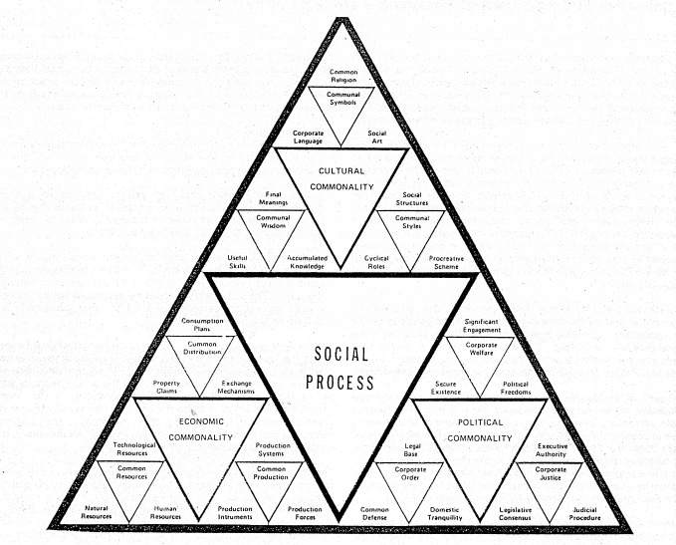
First Steps in this Journey
First things first
  Population Consistency
    % of non-decedents making assignment
    13 months
    25 months
    36 months
ER, Acute and polypharmacy
ESRD, CHF, Oncology
PCP and key medical specialties
  Endo, Neuro, Pulm, Neph
SDOH infrastructure

Slide 16
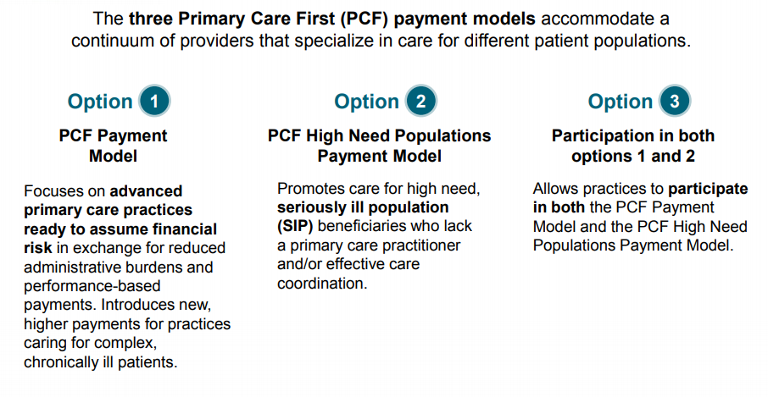
Program Overview
THIS IS NOT CARE CHOICES
Beginning January 2020 organizations can participate in the new CMS Primary Care First payment model. Hospice and Palliative providers are especially well-positioned to support the Seriously Ill Population and to reap the financial benefits

Slide 17
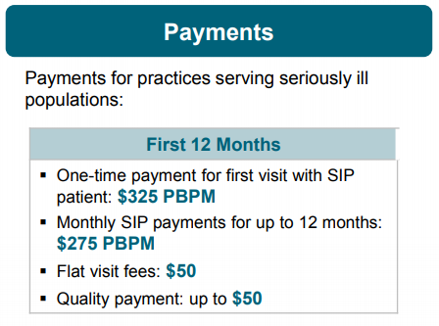
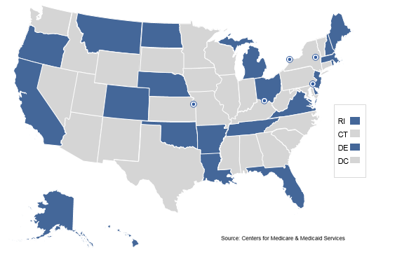
Eligible Regions and Reimbursement

Slide 18
SIP Eligibility
Practices participating in the SIP program provide the following services:
An interdisciplinary care team that includes physician/nurse practitioner, care manager, RN, and social worker. Can also include behavioral health specialist, pharmacist, community services coordinator, and chaplain
Comprehensive, person-centered care management ability, including ability to assess social needs of patients
Relationships with community and medical resources and supports in the community help address social determinants of health, medical, and behavioral health issues
Wellness and healthcare planning
Family and caregiver engagement
24/7 access to a member of the care team
Hospices are uniquely positioned to succeed in this new program

Slide 19
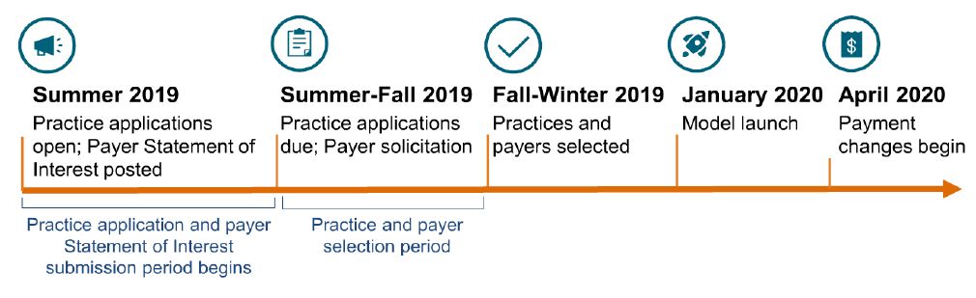
Timeline

Slide 20
Hospices Can’t Afford Not to Participate
Earn more than $275 per beneficiary per month for services you are already providing today for free
Secure a pipeline of hospice-eligible or soon-to-be-eligible patients
Strengthen relationships with community providers by becoming a referral source for them
Get a jump on the hospice carve-in by contracting with Medicare Advantage plans participating in the SIP program

Slide 21
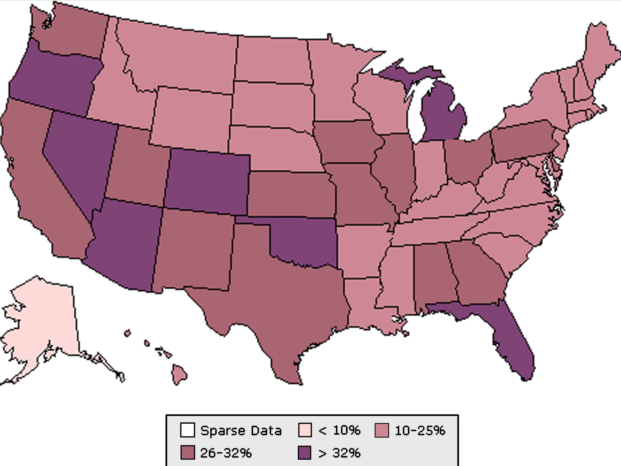
The National Opportunity – about ½ of us included
Notes:
There were considerable geographic differences in hospice utilization among older decedents in the United States by state of residence (Table 3, Fig. 2). States with the highest hospice utilization rates included Arizona (49%), Colorado (45%), and Florida (42%). States with the lowest hospice utilization rates included Alaska (8%), Maine (14%), South Dakota (16%), and Wyoming (16%). In general, hospice utilization was higher in the South and the Southwest and lower in the Midwest and the Northeast.

Slide 22
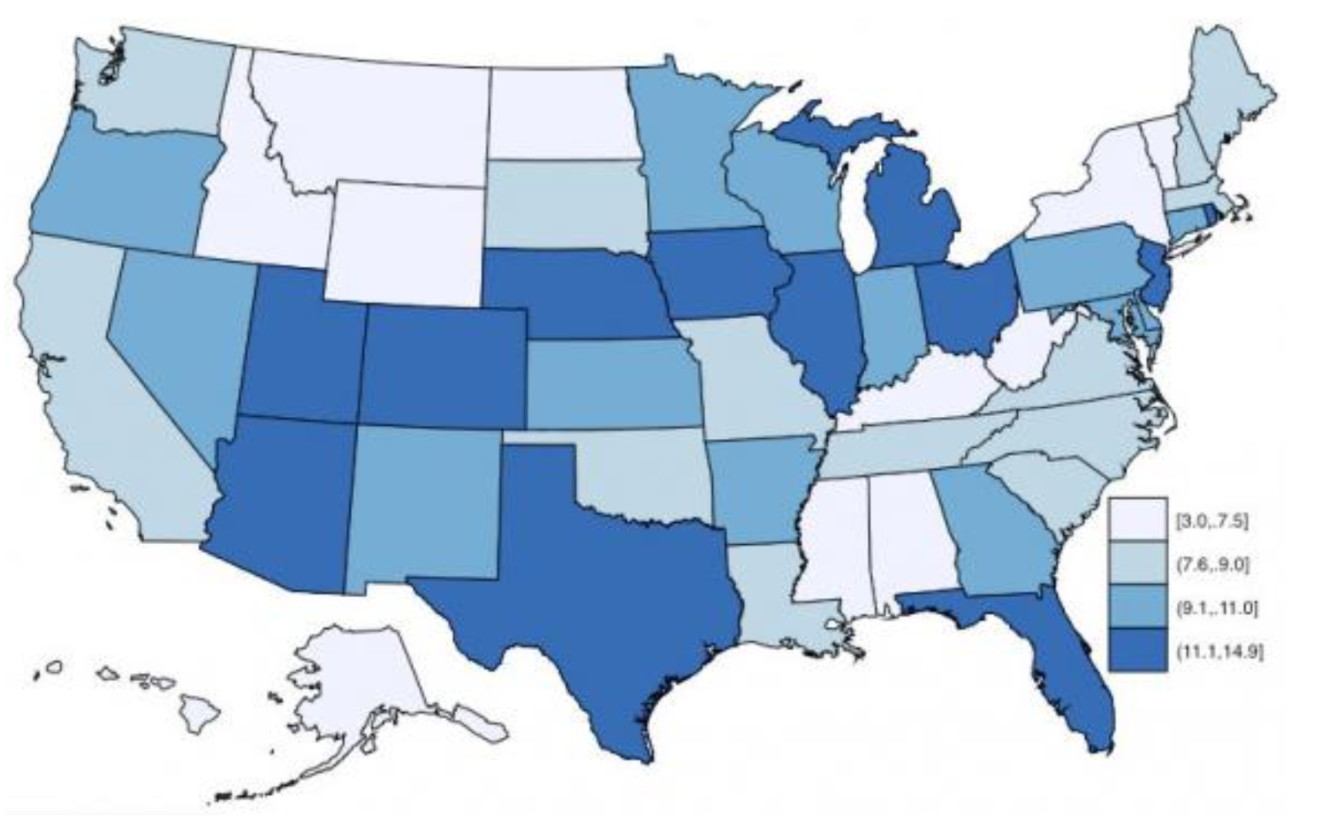
The Details are IMPORTANT
55M Medicare patients
No material Hospice Reimbursement change since 1985
Progressively shorter length of stays
Incredibly difficult to create change from post acute positioning
“Palliative” is an unknown term by 70% of Americans
Notes:
A hospice stay of less than three days suggests patients are not receiving the comfort and psychological support that hospice is meant to provide. Darker states have a higher percentage of hospice stays of less than three days

Slide 23
SIP Opportunity vs. Annual Medicare Deaths (By State)
# of Medicare beneficiaries

Slide 24
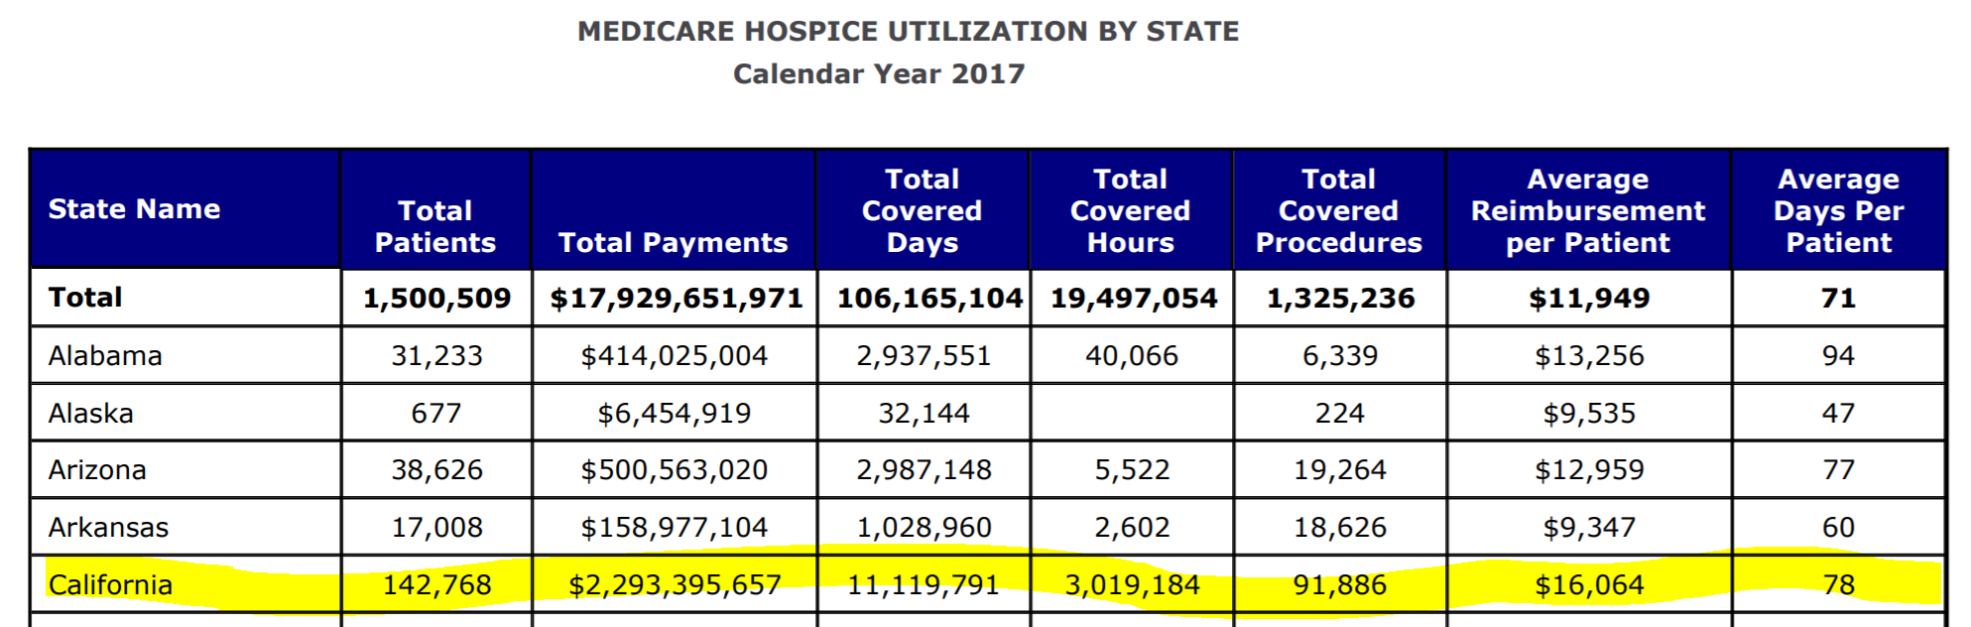
California Opportunity with SIP
Notes:
Note: the number of patients served = 142,768 vs the number in SIP = >218,442 and <327,664 that’s 230% more than the patients served by Hospice

Slide 25
Acclivity Can Help You Get Started
We will support you in the application process (which is non-binding), including providing template responses
We will analyze the raw patient claims files provided by CMS, determining patient acuity and micro-stratifying patients into SIP cohorts
We will assist with modeling incremental staffing requirements and potential financial returns, based on best-practice SIP care models
We will conduct an IT gap analysis, including EHR and reporting requirements
We will identify and support outreach to potential community partners to fill care gaps (if any)
We offer guidance around discussions with non-Medicare payers who opt into the program
We provide access to industry thought leaders and best practices surrounding SIP program
Once the program begins, Acclivity provides ongoing support, analytics, workflow, and reporting capabilities to ensure your success
SIP Assessment Engagement Letter

Slide 26
QUESTIONS AND ANSWERS
Act now! Visit nhpco.org/edge to complete an interest form
Do you have more questions on the content today?
Email info@acclivityhealth.com

Slide 27
Appendix

Slide 28
Alaska Market Opportunity
~82K of Alaska’s population is on Medicare – 1.9% on MA Plans
2,931 patients died in 2017
Average savings opportunity: $20,000 - $45,000 for the last three months
> $60M savings each year in Alaska
Percentage of Medicare decedents enrolled in hospice at the time of death – 22.5%
Decedent Rate: 3.6% in 2017
Estimated SIP Patient Range: 3,298 – 4,947

Slide 29
Arkansas Market Opportunity
~591K of Arkansas’ population is on Medicare – 24.8% on MA Plans
26,340 patients died in 2017
Average savings opportunity: $20,000 - $45,000 for the last three months
> $525M savings each year in Arkansas
Percentage of Medicare decedents enrolled in hospice at the time of death – 50.0%
Decedent Rate: 4.5% in 2017
Estimated SIP Patient Range: 23,652 - 35,479

Slide 30
California Market Opportunity
~5.5M of California’s population is on Medicare – 47.9% on MA Plans
214,972 patients died in 2017
Average savings opportunity: $20,000 - $45,000 for the last three months
> $4.3B savings each year in California
Percentage of Medicare decedents enrolled in hospice at the time of death – 45.2%
Decedent Rate: 3.9% in 2017
Estimated SIP Patient Range: 218,442 – 327,664

Slide 31
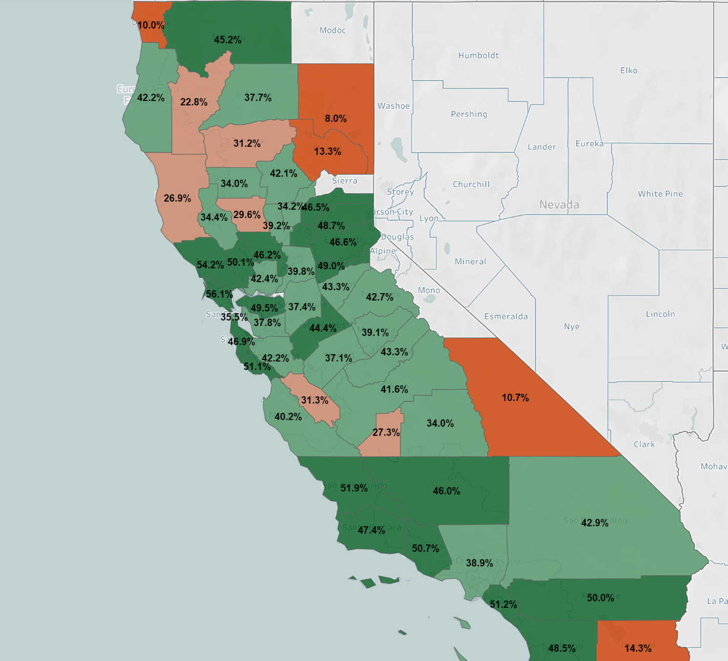
The California Opportunity
5.5M Medicare patients
30 years of PCP capitation
Progressive payers
Vast number of hospices
Less than 40% use hospice on average
What will CMS look at in terms of this program being a success?

Slide 32
Colorado Market Opportunity
~787K of Colorado’s population is on Medicare – 42.0% on MA Plans
29,547 patients died in 2017
Average savings opportunity: $20,000 - $45,000 for the last three months
> $590M savings each year in Colorado
Percentage of Medicare decedents enrolled in hospice at the time of death – 53.2%
Decedent Rate: 3.8% in 2017
Estimated SIP Patient Range: 31,498 – 47,247

Slide 33
Delaware Market Opportunity
~184K of Delaware’s population is on Medicare – 13.4% on MA Plans
7,315 patients died in 2017
Average savings opportunity: $20,000 - $45,000 for the last three months
> $145M savings each year in Delaware
Percentage of Medicare decedents enrolled in hospice at the time of death – 57.9%
Decedent Rate: 4.0% in 2017
Estimated SIP Patient Range: 7,371 – 11,057

Slide 34
Florida Market Opportunity
~4.1M of Florida’s population is on Medicare – 46.4% on MA Plans
164,248 patients died in 2017
Average savings opportunity: $20,000 - $45,000 for the last three months
> $3.3B savings each year in Florida
Percentage of Medicare decedents enrolled in hospice at the time of death – 57.9%
Decedent Rate: 4.0% in 2017
Estimated SIP Patient Range: 165,777 – 248,665

Slide 35
Hawaii Market Opportunity
~231K of Hawaii’s population is on Medicare – 53.0% on MA Plans
9,296 patients died in 2017
Average savings opportunity: $20,000 - $45,000 for the last three months
> $185M savings each year in Hawaii
Percentage of Medicare decedents enrolled in hospice at the time of death – 46.1%
Decedent Rate: 4.0% in 2017
Estimated SIP Patient Range: 9,238 – 13,857

Slide 36
Louisiana Market Opportunity
~759K of Louisiana’s population is on Medicare – 37.1% on MA Plans
34,673 patients died in 2017
Average savings opportunity: $20,000 - $45,000 for the last three months
> $690M savings each year in Louisiana
Percentage of Medicare decedents enrolled in hospice at the time of death – 49.7%
Decedent Rate: 4.4% in 2017
Estimated SIP Patient Range: 31,789 – 47,684

Slide 37
Maine Market Opportunity
~306K of Maine’s population is on Medicare – 31.2% on MA Plans
12,270 patients died in 2017
Average savings opportunity: $20,000 - $45,000 for the last three months
> $245M savings each year in Maine
Percentage of Medicare decedents enrolled in hospice at the time of death – 50.6%
Decedent Rate: 4.0% in 2017
Estimated SIP Patient Range: 12,226 – 18,339

Slide 38
Massachusetts Market Opportunity
~1.2M of Massachusetts’ population is on Medicare – 26.5% on MA Plans
48,396 patients died in 2017
Average savings opportunity: $20,000 - $45,000 for the last three months
> $965M savings each year in Massachusetts
Percentage of Medicare decedents enrolled in hospice at the time of death – 47.1%
Decedent Rate: 4.1% in 2017
Estimated SIP Patient Range: 46,861 – 70,292

Slide 39
Michigan Market Opportunity
~1.9M of Michigan’s population is on Medicare – 39.6% on MA Plans
79,310 patients died in 2017
Average savings opportunity: $20,000 - $45,000 for the last three months
> $1.6B savings each year in Michigan
Percentage of Medicare decedents enrolled in hospice at the time of death – 53.7%
Decedent Rate: 4.1% in 2017
Estimated SIP Patient Range: 76,794 – 115,191

Slide 40
Montana Market Opportunity
~206K of Montana’s population is on Medicare – 22.6% on MA Plans
8,241 patients died in 2017
Average savings opportunity: $20,000 - $45,000 for the last three months
> $165M savings each year in Montana
Percentage of Medicare decedents enrolled in hospice at the time of death – 43.4%
Decedent Rate: 4.0% in 2017
Estimated SIP Patient Range: 8,220 – 12,330

Slide 41
Nebraska Market Opportunity
~311K of Nebraska’s population is on Medicare – 14.6% on MA Plans
13,940 patients died in 2017
Average savings opportunity: $20,000 - $45,000 for the last three months
> $265M savings each year in Nebraska
Percentage of Medicare decedents enrolled in hospice at the time of death – 50.8%
Decedent Rate: 4.5% in 2017
Estimated SIP Patient Range: 12,454 – 18,681

Slide 42
New Hampshire Market Opportunity
~258K of New Hampshire’s population is on Medicare – 12.5% on MA Plans
10,435 patients died in 2017
Average savings opportunity: $20,000 - $45,000 for the last three months
> $205M savings each year in New Hampshire
Percentage of Medicare decedents enrolled in hospice at the time of death – 47.5%
Decedent Rate: 4.0% in 2017
Estimated SIP Patient Range: 10,310 – 15,465

Slide 43
New Jersey Market Opportunity
~1.4M of New Jersey’s population is on Medicare – 25.8% on MA Plans
61,071 patients died in 2017
Average savings opportunity: $20,000 - $45,000 for the last three months
> $1.2B savings each year in New Jersey
Percentage of Medicare decedents enrolled in hospice at the time of death – 44.7%
Decedent Rate: 4.3% in 2017
Estimated SIP Patient Range: 56,726 – 85,088

Slide 44
North Dakota Market Opportunity
~118K of North Dakota’s population is on Medicare – 20.7% on MA Plans
5,198 patients died in 2017
Average savings opportunity: $20,000 - $45,000 for the last three months
> $100M savings each year in North Dakota
Percentage of Medicare decedents enrolled in hospice at the time of death – 29.7%
Decedent Rate: 4.4% in 2017
Estimated SIP Patient Range: 4,704 – 7,056

Slide 45
Ohio Market Opportunity
~2.1M of Ohio’s population is on Medicare – 42.9% on MA Plans
96,799 patients died in 2017
Average savings opportunity: $20,000 - $45,000 for the last three months
> $1.9B savings each year in Ohio
Percentage of Medicare decedents enrolled in hospice at the time of death – 56.4%
Decedent Rate: 4.5% in 2017
Estimated SIP Patient Range: 85,506 – 128,260

Slide 46
Oklahoma Market Opportunity
~668K of Oklahoma’s population is on Medicare – 20.3% on MA Plans
31,452 patients died in 2017
Average savings opportunity: $20,000 - $45,000 for the last three months
> $625M savings each year in Oklahoma
Percentage of Medicare decedents enrolled in hospice at the time of death – 49.1%
Decedent Rate: 4.7% in 2017
Estimated SIP Patient Range: 26,707 – 40,060

Slide 47
Oregon Market Opportunity
~765K of Oregon’s population is on Medicare – 49.2% on MA Plans
29,891 patients died in 2017
Average savings opportunity: $20,000 - $45,000 for the last three months
> $595M savings each year in Oregon
Percentage of Medicare decedents enrolled in hospice at the time of death – 53.9%
Decedent Rate: 3.9% in 2017
Estimated SIP Patient Range: 30,594 – 45,891

Slide 48
Rhode Island Market Opportunity
~192K of Rhode Island’s population is on Medicare – 50.4% on MA Plans
8,593 patients died in 2017
Average savings opportunity: $20,000 - $45,000 for the last three months
> $170M savings each year in Rhode Island
Percentage of Medicare decedents enrolled in hospice at the time of death – 55.0%
Decedent Rate: 4.5% in 2017
Estimated SIP Patient Range: 7,667 – 11,501

Slide 49
Tennessee Market Opportunity
~1.2M of Tennessee’s population is on Medicare – 40.4% on MA Plans
55,373 patients died in 2017
Average savings opportunity: $20,000 - $45,000 for the last three months
> $1.1B savings each year in Tennessee
Percentage of Medicare decedents enrolled in hospice at the time of death – 43.7%
Decedent Rate: 4.4% in 2017
Estimated SIP Patient Range: 49,802 – 74,703

Slide 50
Virginia Market Opportunity
~1.3M of Virginia’s population is on Medicare – 22.4% on MA Plans
54,841 patients died in 2017
Average savings opportunity: $20,000 - $45,000 for the last three months
> $1.1B savings each year in Virginia
Percentage of Medicare decedents enrolled in hospice at the time of death – 45.3%
Decedent Rate: 4.1% in 2017
Estimated SIP Patient Range: 52,880 – 79,320

