Slide 1
PowerPoint Template
Understanding Hospice and Palliative Care
This presentation is intended as a template.
Modify and/or delete slides as appropriate for your organization and community.
Delete this slide before use.
To view speaker notes and edit presentation, click 'Edit', then 'Edit slides.’
Add your organization’s name & contact info – and your logo if you like.

Slide 2
Understanding Hospice and Palliative Care

Slide 3
Fact
25% of deaths occur at home - more than 80% of Americans would prefer to die at home.
Notes:
Research from the National Hospice and Palliative Care Organization and National Hospice Foundation.

Slide 4
Understanding Hospice Care

Slide 5
Hospice Care
Provides support and care for those in the last phases of life-limiting illness.
Recognizes dying as part of the normal process of living.
Affirms life and neither hastens nor postpones death.
Focuses on quality of life for individuals and their family caregivers.

Slide 6
Core Aspects of Hospice Care
Person- and family-centered
Interdisciplinary team care
Provides a range of services:
  Interdisciplinary case management
  Pharmaceuticals
  Durable medical equipment
  Supplies
  Volunteers
  Grief support
Notes:
As defined by Medicare Hospice Benefit.

Slide 7
Additional Services
Hospices offer additional services, including:
Hospice residential care (facility)
Inpatient hospice care
Complementary therapies
Specialized pediatric team
Caregiver training
Community bereavement services
Notes:
Not all programs offer these – based on needs in community, mission, resources, skills

Slide 8
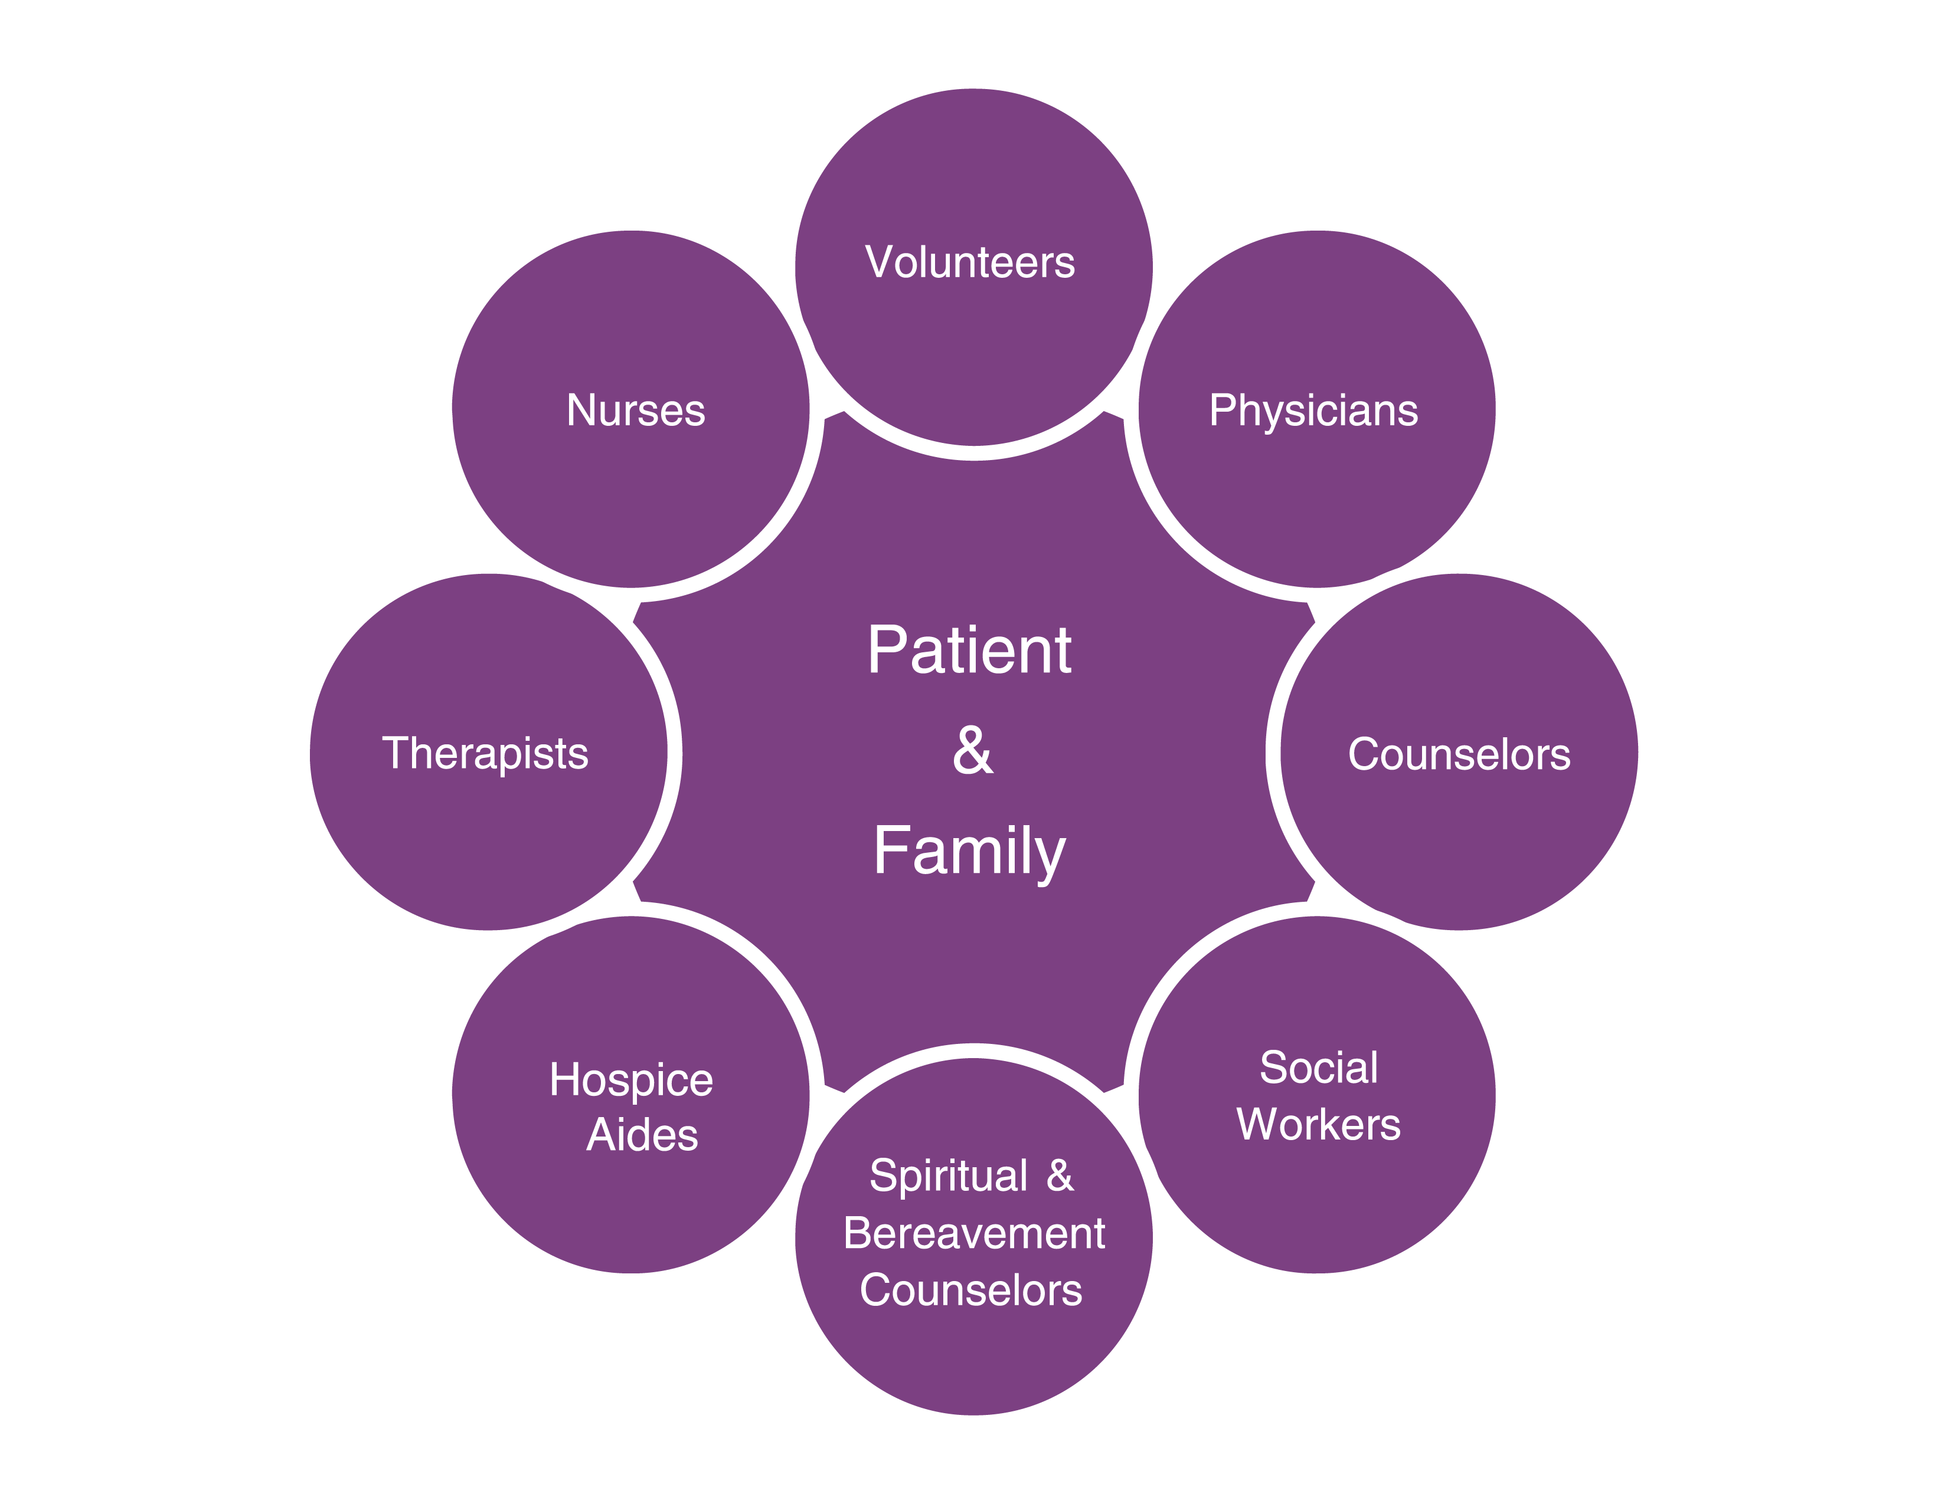
Hospice Team Members
Notes:
Palliative care programs may not include all these disciplines as palliative care is not regulated by Medicare Hospice Benefit Conditions of Participation.

Slide 9
Work of the Hospice Team
Develops the plan of care
Manages pain and symptoms
Attends to the emotional, psychosocial and spiritual aspects of dying and caregiving
Teaches the family how to provide care
Advocates for the patient and family
Provides bereavement care and counseling
Notes:
These are primary services offered by hospice. Not all patients/families avail themselves of these services.
Develops the plan of care with the family
Manages pain and symptoms
Attends to the emotional, psychosocial and spiritual aspects of dying and caregiving
Teaches the family how to provide care
Advocates for care needs of patient and family
Provides bereavement care and counseling to surviving family and friends.

Slide 10
Where is Hospice Provided?
Home – the patient’s or loved one’s home
Nursing Facility
Assisted Living Facility
Hospital
Hospice residence or unit
Correctional setting, homeless shelter – wherever the person is located
Notes:
Hospice care may be delivered across all care settings.

Slide 11
Who Pays?
Medicare
Medicaid
Insurance and HMOs
Private pay
Sometimes a combination of these…

Slide 12
Admission Criteria
To qualify for hospice care, these are the general requirements:
Life-limiting illness, prognosis is 6 months or less if the disease takes normal course
Live in the service area
Consent to accept services
Forgo other medical interventions for the terminal illness

Slide 13
Understanding Palliative Care

Slide 14
What is Palliative Care?
Treatment that enhances comfort and improves the quality of an individual’s life who is facing a serious illness but may not quality for hospice care.
The expected outcome is relief from distressing symptoms, the easing of pain, and/or enhancing the quality of life.
Notes:
Some think of palliative care as hospice that isn’t defined by the 6 month hospice benefit. It’s important to understand the subtle differences between palliative care and hospice.
Most hospices were “designed” based on the HMB model. That model limits admission to hospice to those with 6 mo prognosis and the discontinuation of “curative” treatments. Palliative care doesn’t have those limitations. Palliative care programs don’t have to provide the same range of core services – IDT, bereavement, spiritual, social work, patient/family, etc. We’ll talk more about this as we explore the hospice model.
All hospice is palliative, all palliative isn’t hospice and doesn’t have to provide same range of services.

Slide 15
Kinds of Care
Curative Care:
Focuses on a cure to an illness and the prolonging of life.
Palliative Care:
Focuses on comfort and quality of life that may be provided with other treatments.
Hospice Care:
Focuses on comfort and quality of life when a cure is not possible with specialize care and services.
Notes:
When a patient’s disease process is no longer curable or reversible, aggressive curative treatment begins to be less appropriate and may be considered harmful.
Hospice philosophy emphasizes palliative care, which can be as aggressive as curative care, with a
focus on comfort, quality of life, and patient-/family-directed care that promotes the patient’s right to
self-determination and decision-making.
Curative care: Focuses on quantity of life and prolonging of life.
Curative care can actually cause more suffering when cure is no longer possible and treatments and procedures needlessly extend the period of suffering.
Quality of life is often elusive if a patient is subjected to treatments and interventions that he/she did not choose, such as respirators, intravenous infusion and tube feedings.
Within the hospice philosophy, patients are encouraged to complete advance directives. patients’ choices regarding resuscitation measures and curative treatments are respected and honored by hospice.
Palliative care: Focuses on quality of life and death, and views death as a natural part of life.
Palliative care is a lessening and relief of physical, psychosocial and spiritual suffering so that the patient can accomplish his/her goals and life-closure tasks.
Closure tasks may include saying goodbye, letting go, finding meaning and value in life and death, and mending relationships.
Control and management of physical, emotional, psychosocial and spiritual pain and suffering and other end-of-life issues are paramount.
Determining specific things that bring quality of life to each patient
Hospice care: The most intensive comfort care available that focuses on quality of life; generally intended for the final months of life when a patient with a terminal illness decides to forgo other treatments for that disease.
Questions?

Slide 16
Services that We Offer the Community
[Outline that services and programs that you organization make available…]

Slide 17
Resources in our Community
[List resources that can include your organization and others…]

Slide 18
Online Resources
National Hospice and Palliative Care Organization’s CaringInfo website offers some useful resources with free materials.
www.CaringInfo.org – with information and tools to help people facing serious illness, including help with advance care planning, caregiving, and grief.

Slide 19
QUESTIONS?

Slide 20
THANK YOU!

